Slide 1
CASE STUDY INTRODUCTION
World CO2 Emission
In this Case study, I will be examining the effect and threat the global emission of CO2 poses to all the continents and countries across the world. By analysis the dataset provided to me and gaining a conclusive insights from my analysis to provide solutions and recommendations.

Slide 2
Scenario
Having extracted the CO2 dataset from my drive as one of the dataset used in my previous lessons, it was easy and direct for me to work with. Knowing fully well the negative and detrimental effect CO2 has caused to our ecosystem and contribution Carbon (iv) oxide to the atmosphere, I took one step further into investigating how much emission of this dangerous gas has contributed into destroying our atmosphere, the air we breathe and the condition of the Ozone layer, with my analysis.

Slide 3
The CO2 Dataset
Going through the dataset for sorting and formatting the following steps were taking
Proper examining of the data to be sure it is error-free, sorted and formatted before carrying out the analysis
The use of pivot table on a spreadsheet to zoom in on the data properly

Slide 4
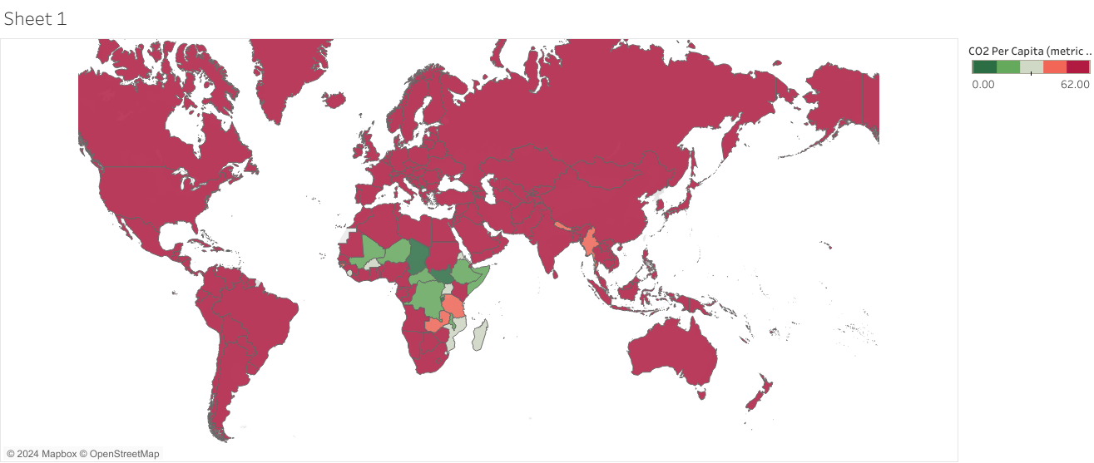
Global Emission of CO2

Slide 5
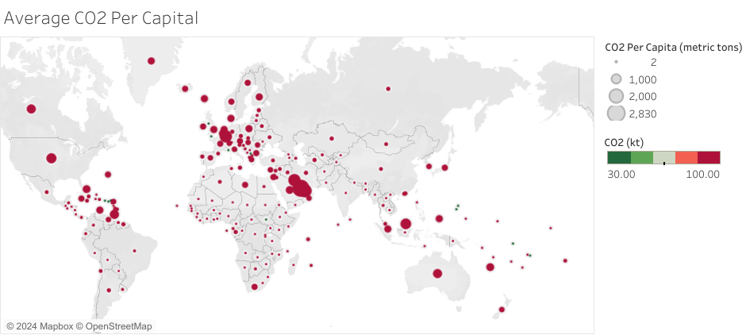
Average CO2 Per Capital

Slide 6
Average CO2 Per Capital
From this visualization, it can be seen how the emission of CO2 is distributed globally on the world map and the continents and countries it has affected with the red circle as an indicator.

Slide 7
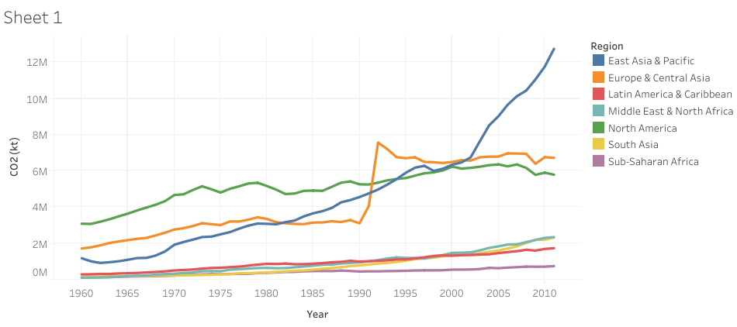
CO2 Production By Region

Slide 8
CO2 Production By Region
In this visualization, it clearly seen the trend of CO2 emission in all continents of the world from 1960 to 2016.

Slide 9
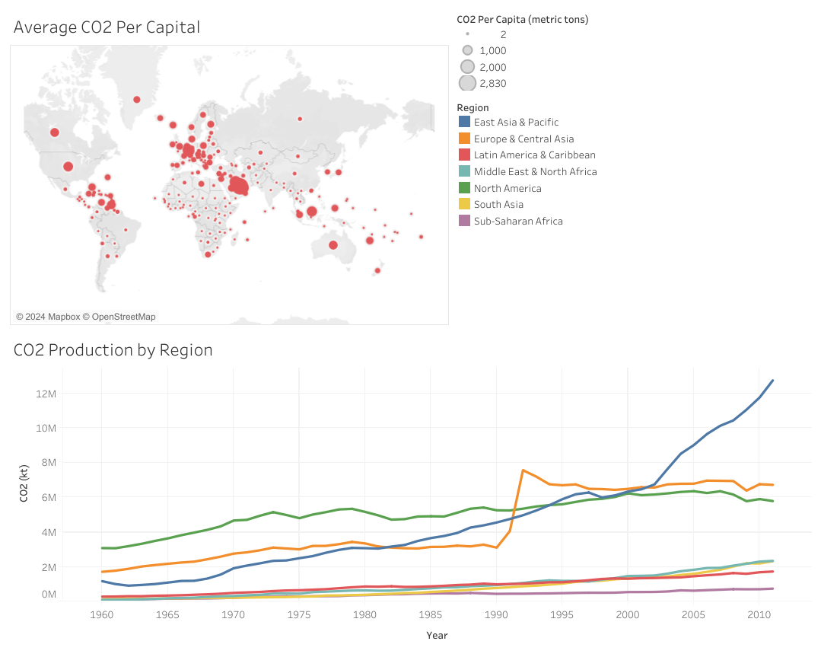
Dashboard Presentation Average CO2 Per capital and CO2 Production by Region Visualization

Slide 10
Dashboard
For more insights, this dashboard showcases the visualizations of Average CO2 Per Capital and CO2 Production by region for more insights.

Slide 11
Recommendations
This Case study has shown the emission of CO2 all around the world and the danger it poses. If this continues like this, then the world is in a greater danger of been destroyed by the emission of CO2(KT).
From this analysis, it will strictly advised that the entirety of the world ( the continents and all the countries ) should cut down the emission CO2 to lowest.
As we all know all negativities associated with amount CO2 in the climate and ecosystem and if this continues at this rate over the next ten years.

Slide 12
THE END
THANK YOU

